Slide 1

MONARCH INDIA INFRACON Private limited

Slide 2

About MIIPL
Since 1990, Monarch Group engaged in civil construction business. We are civil construction contractors, specialized in constructing Solar Power Plant, multi-storied residential, commercial and various industrial structures. We had successfully completed many buildings, small bridges and culverts and quality assured concrete works. We had also undertaken construction of road, drainage & other infrastructural development projects.
With a vast experience in the field of civil construction in Gujarat for more than 20 years, we have built our reputation through our excellent service and high standard of workmanship. Our expert team employs its experience and expertise in using modern equipments for better and reliable civil construction.

Slide 3
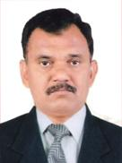
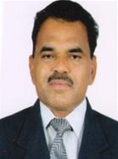
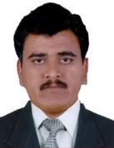
MANAGEMENT MIIPL
[DIRECTORS OF THE COMPANY]
Er. Ujamshi I. Khandla (B.E. Civil)
Managing Director
He has 20 years of variegated & versatile experience, expertise
and knowledge in the field of construction.
Mr. Vinod I. Khandla
Director
He has an extensive experience of 20 years in the field of construction on site management.
Mr. Deepak I. Khandla
Director
He has varied experience of 20 years in the field of construction in finance & administration.

Slide 4
“Total Turnkey Solution Provider”
Solar & Thermal Power Plant Project.
Industrial & College Building Project.
Commercial Building Project.
Residential Building Project.
Heritage Buildings.
Land Survey and Land Procurement
Roads, Culverts, Drainage & etc.

Slide 5
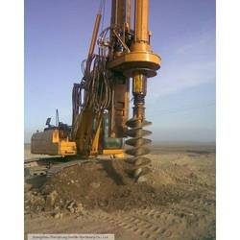
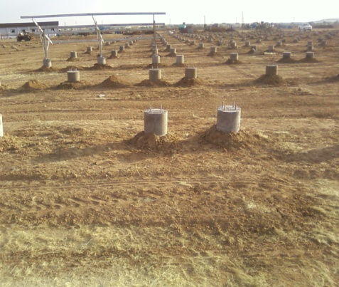
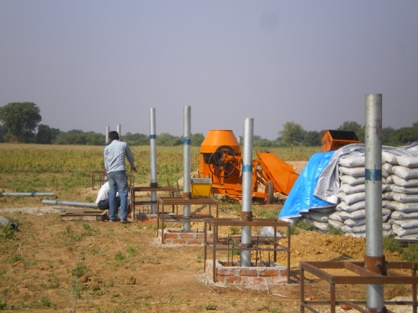
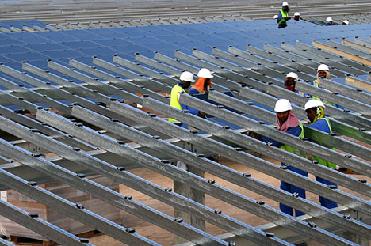
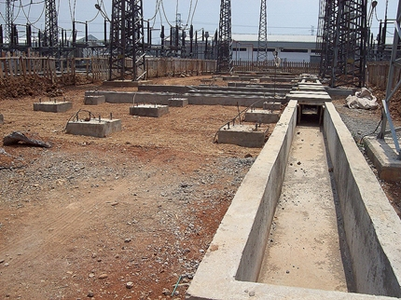
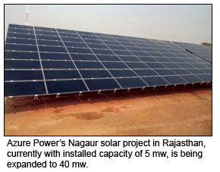

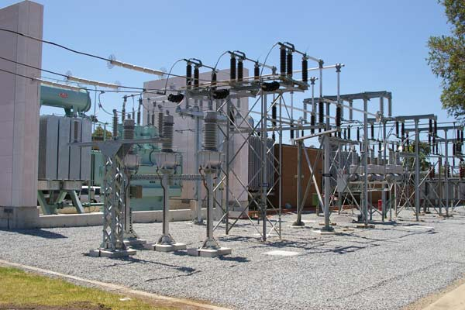
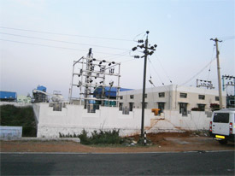
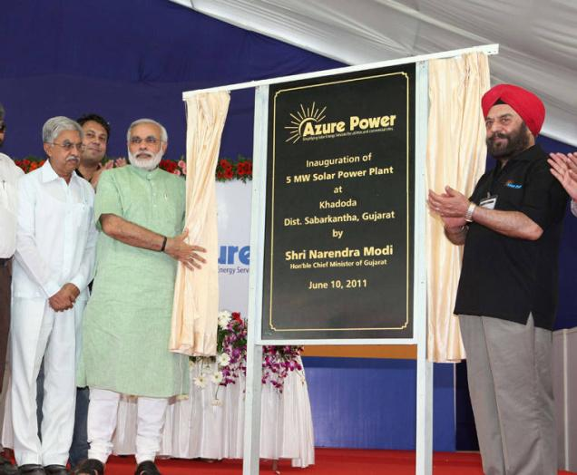

SOLAR & thermal POWERPLANT PROJECT
Azure Power (Rajasthan) Pvt. Ltd., (15 MW SPP & 5 MW SPP at Rajasthan)
Azure Power(Gujarat)Pvt. Ltd.,(5.0MW SPP Inaugurated by Mr. Narendra Modi (CM, Gujarat)
Euro Ceramic Thermal Power plant & Gasi fire, Bhachau, Gujarat.

Slide 6
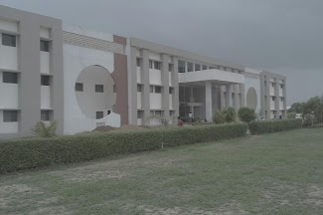
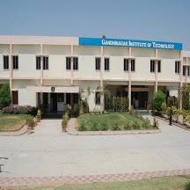
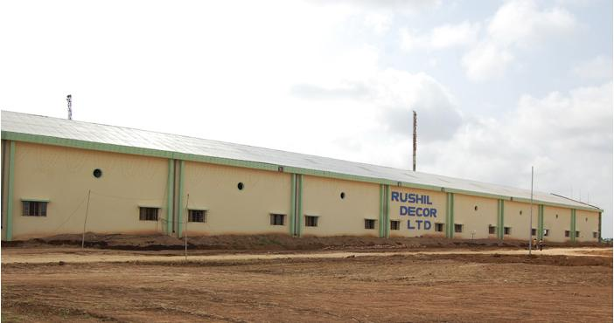
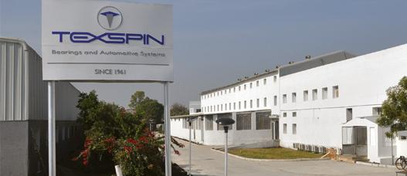

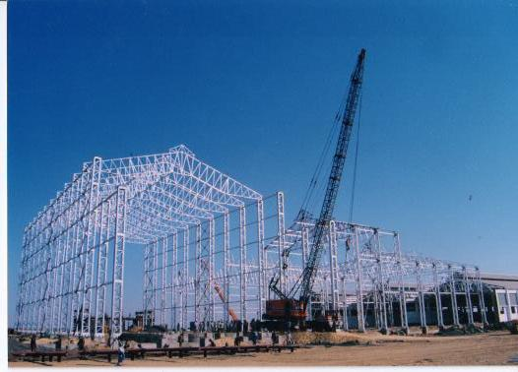
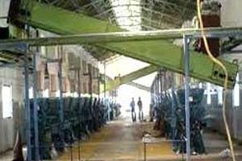
INDUSTRIAL & college BUILDING Project
Universal College of Engineering, Gandhinagar Institute of Rushil Décor Ltd. Gujarat. Texspin Bearing ltd, Ranpur.
Global Foundation - Gujarat. Technology, Gandhinagar.
Euro Ceramic ltd., Bhachau. Gujarat. Industrial Shed, Bhachau, Gujarat. Ginning Industries.

Slide 7
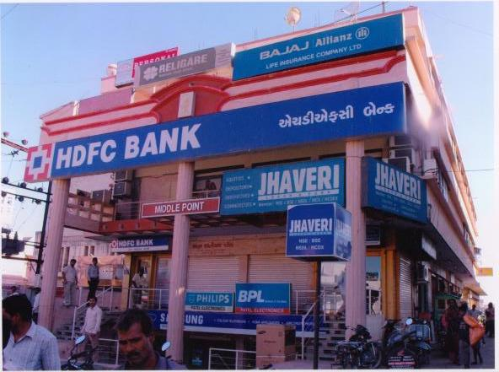
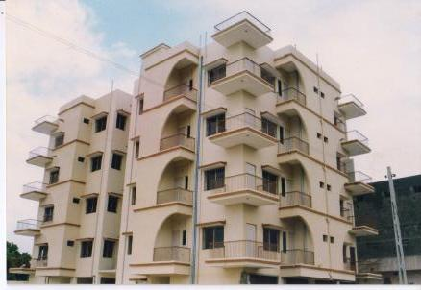
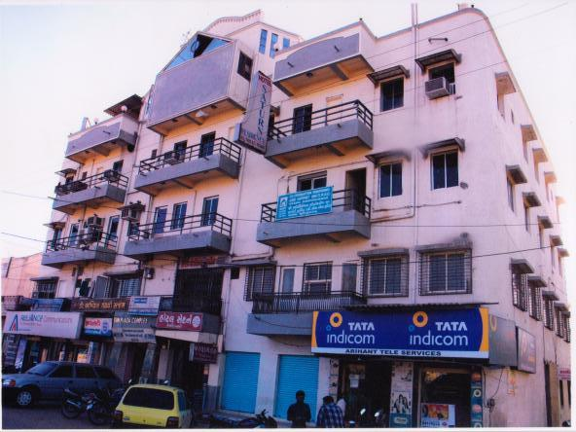
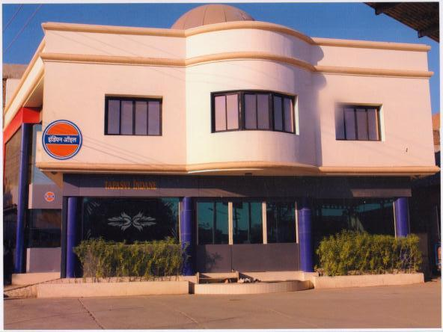
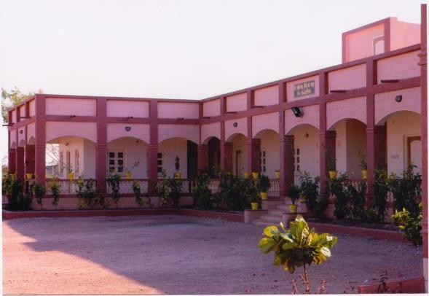
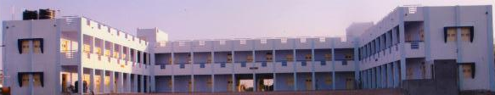
COMMERCIAL BUILDING PROJECT
Middle Point Complex, Surendranagar. Hare krishna Apartment , Sun Plaza Complex, Surendranagar.
Surendranagar,
Indian Oil, Mandavraiji H.O., Gujarat Sanatorium, Limbadi. Dharamshala, Dwarka.

Slide 8
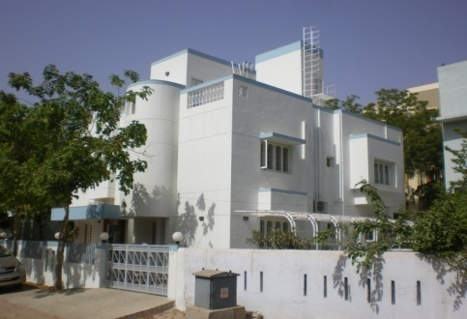
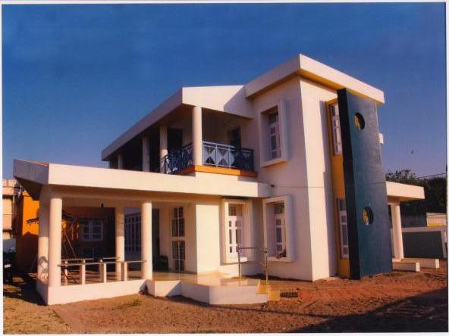
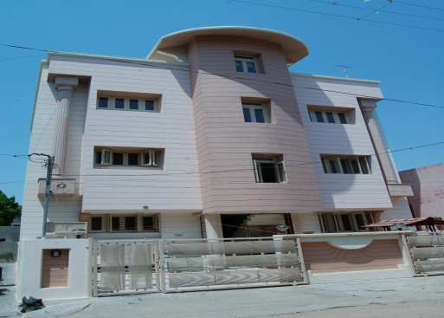
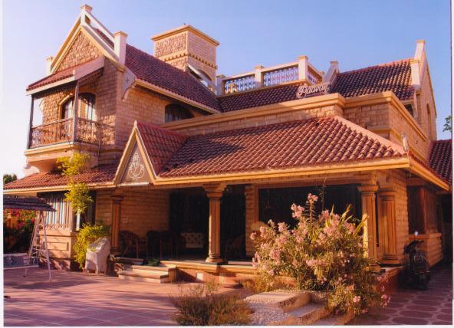
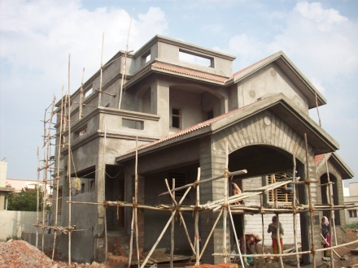
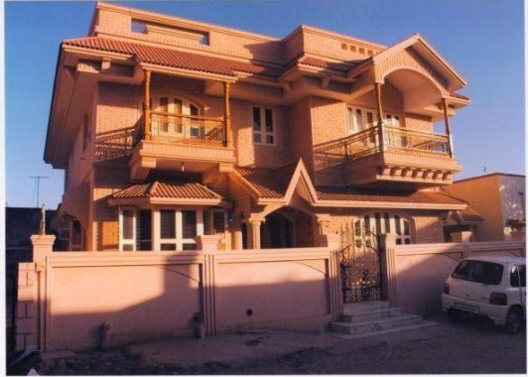
RESIDENTIAL PROJECT
Bungalow at Ahmedabad, Gujarat. Bungalow at Limbdi, Gujarat. Bungalow at Surendranagar, Gujarat.
Bungalow at Surendranagar, Gujarat. Bungalow at Limbdi, Gujarat Bungalow at Surendranagar, Gujarat.

Slide 9
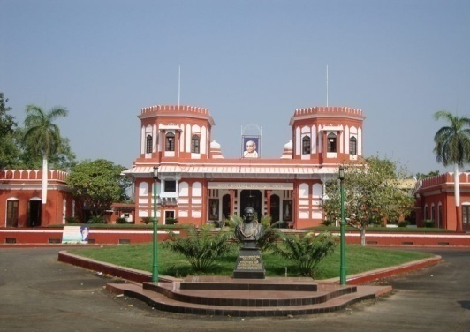
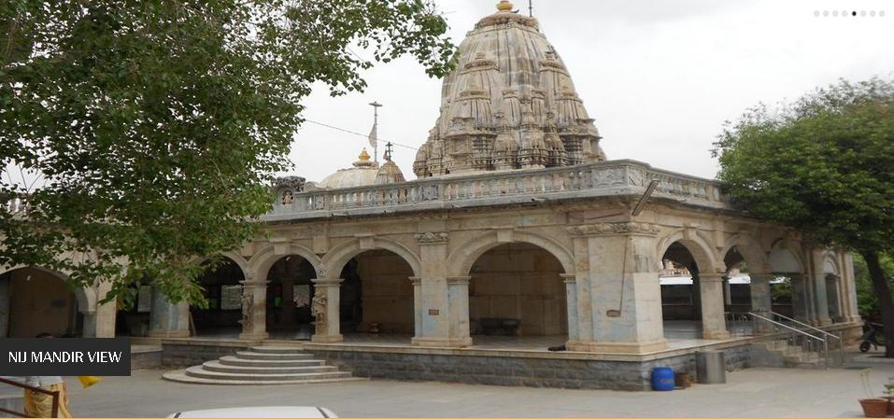
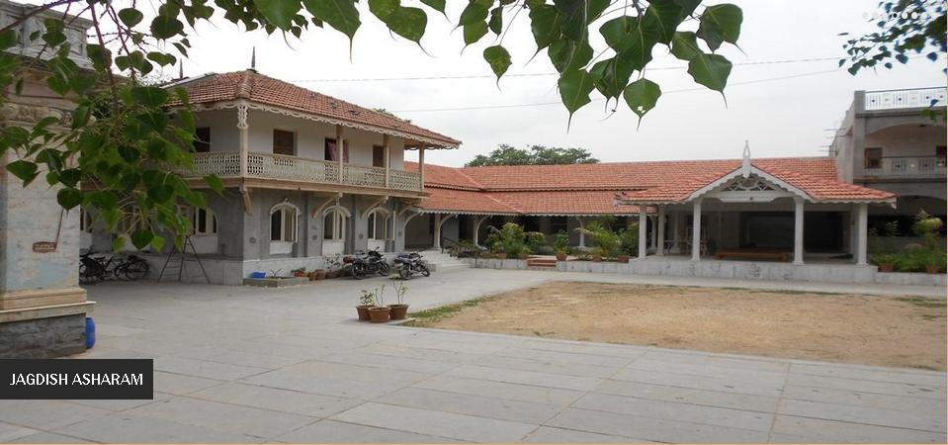
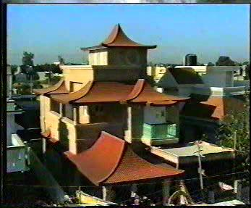
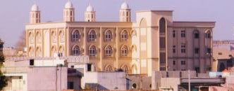
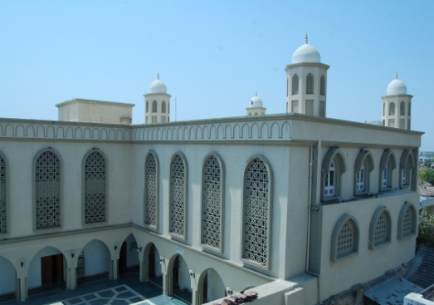
HERITAGE project
Sardar Vallabhbhai Patel Memorial Society, Nij Mandir, Shri Jagdish Ashram. Shri Jagdish Ashram, Limbadi, Gujarat.
(Museum) Shahibaugh,Ahmedabad, Gujarat.
Pagoda Style Bungalow, Surendranagar. Mosque at Surendranagar. Daudi Vohra Mosque, Surendranagar

Slide 10
Land facilitators –brokers-farmers Networking.
Land survey, Demarcation & Phase wise Planning.
Price Negotiation.
Land aggregation and strategic tie-ups with land owners via primary documentation.
Land legal Clearance Services.
Other Government clearances.
Land valuation and Registration.
Post registration services.
Peaceful Possession.
Land SURVEY & LAND PROCUREMENT

Slide 11
Rich Experience, Knowledge and Expertise.
Quality of services.
Total Solutions through Single Window Assistance.
Consultancy for Best Construction Options.
Focus on Long, Trustworthy and crystal clear harmonious Business relationships.
Proper Understanding of Client’s Requirement & Needs.
Hassle free services through strong documentation.
Complete Transparency in business.
Excellence in Service and Quality in implementation.
MIIPL ADVANTAGE

Slide 12

MONARCH INDIA INFRACON Private limited
Head Office Branch Office
6th Ravi Pushp Apartment, 3rd floor 12/13, Mahajan Building,
Behind Navneet prakashan, 1st floor, Opp. Mega Mall,
Off Gurukul Road, Memnagar. Tramway Road,
Ahmedabad : 380 052, Gujarat – India. Surendranagar : 363001.
Tele. + 91 – 79 – 27431908. Gujarat - India.
Fax : + 91 – 79 – 27499963. Tele - fax : + 91 – 2752 – 235958.
Website: www.monarchgroupindia.com Email: info@monarchgroupindia.com
Website: www.monarchlifespace.com Email: info@monarchlifespace.com

Slide 13

GO GREEN - CONSERVE ENVIRONMENT
Innovative Concept Delivered

